Slide 1
Day 2
Cardiac Cycle, Arteries, Cardiomegaly, Sinus Rhythm

Slide 2
Review
Day 1 Overview

Slide 3
Cardiac Cycle
Depolarization
Systole
Contraction
Repolarization
Diastole
Relaxation
1 cycle equals .80 seconds
Atrial Systole – 0.01 Second
Ventricle Systole – 0.3 Second
Atrial Diastole – 0.70 Seconds
Ventricle Diastole – 0.501

Slide 4
Heart Needs Blood
Heart pumps about 5000 mL/min
250mL/Min = Coronary Arteries
About 4-5% of Cardiac Output

Slide 5
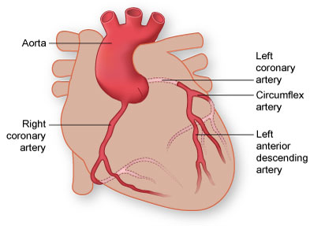
Arteries
Lay on Epicardial Surface
Supplies Myocardium
Two Major Branches
Left
Right
3 Main Arteries Contribute Supply
LAD
LCx
RCA

Slide 6
Left Anterior Descending (LAD)
Supplies
Anterior Surface of Left Ventricle
Part of Lateral Surface of Left Ventricle
Most of Interventricular Septum

Slide 7
Left Circumflex Artery (LCx)
Supplies
Left Atrium
Lateral, Posterior, and Inferior surface of Left Ventricle
SA Node (40%)
AV Node (10-15%)

Slide 8
Right Coronary Artery (RCA)
Supply
Right Atrium & Ventricle
Inferior Surface of Left Ventricle
Posterior Surface of Left Ventricle
SA Node (60%)
AV Node (85-90%)

Slide 9
Intrinsic Rates
SA Node
60-100 BPM
AV Node/Junction
40-60 BPM
Purkinje Fibers
20-40 BPM

Slide 10
Hypertrophy or Enlargment
Hypertrophy
Growth in Mass
Enlargement
Growth via Volume/Pressure
EKG Cant differ
P Waves and QRS Complexes are our “Indication”

Slide 11
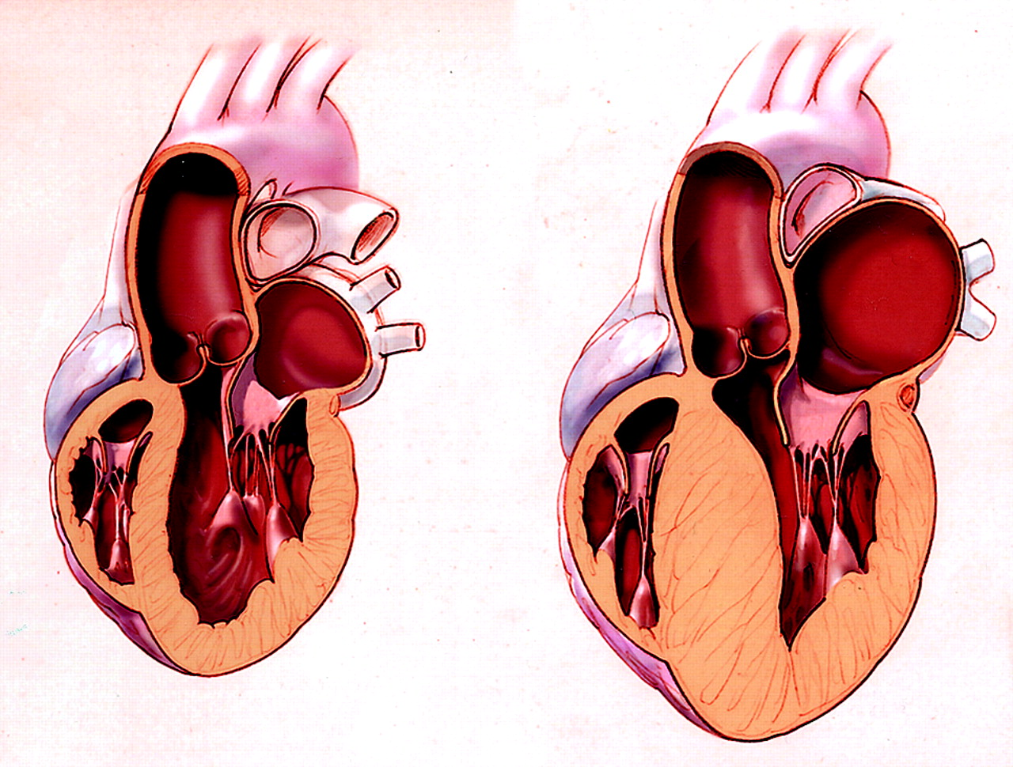
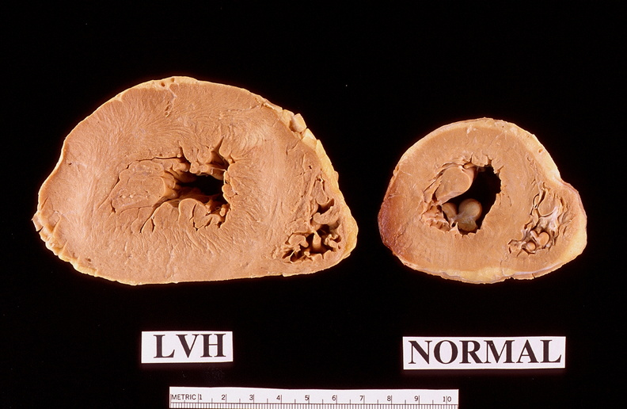
Hypertrophy

Slide 12
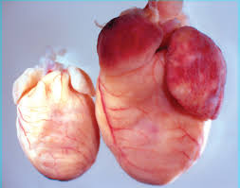
Enlargment

Slide 13
P Waves & QRS Complex
Atrial Enlargement
P Waves
Ventricular Hypertrophy
QRS Complexes

Slide 14
So what changes?
Depolarization takes longer
Duration Increases
More current needed
Amplitude Increases
Current Altered
Circle of Orientation
Axis Shift

Slide 15
So what is normal?
PR Interval
0.12 - .20 seconds
QRS Complex
.06-.10 Seconds
P Waves
<.12 Seconds
Deflection <2.5mm

Slide 16
Lead Electro activity
L1 – Positive
L2 – Positive
L3 – Positive (Pwave can be negative)
aVR – Negitive
aVL – Isometric
aVF – Positive
V1 – Pwave (+/-) QRS –
V2 – Pwave (+/-) QRS- Biphasic
V3- Pwave + QRS – Biphasic
V4 – Pwave + QRS – Biphasic
V5 – Positive
V6 - Positive

Slide 17
Counting HR
Two common ways
1500
Times 10 * easiest

Slide 18
Take a 10 Min Break

Slide 19
Let’s Practice
So if we can recall:
Each Big Box represents .20 Seconds
5 Big boxes would equal 1 full second
30 Large Boxes equal 6 seconds
300 Large Boxes would equal 1 minute

Slide 20
Lets Calculate the HR

Slide 21
Sinus Rhythms

Slide 22
Sinus
Sinus means nothing more then normal
For a rhythm to be normal lets recall:
P Wave
QRS
T wave
Normal Rhythms are normally originated in the SA node
60-100BPM

Slide 23
Things can Change
5 major factors of a change in Sinus Rhythm
HIS DEBS
Hypoxia
Ischemia/ Irritability
Symptomatic Stimulation
Drugs
Electrolyte Disturbance/ Imbalance
Bradycardia
Stretch

Slide 24
Rhythm Strips
Any acute rhythm strip should be no less then 6 seconds; sometimes longer are needed
Holter Monitor records 24+ hours

Slide 25
Signs and Symptoms of Cardiac Conditions
Angina
Light Headed
Syncope
Dizziness
Confusion
Death
Prolonged QT interval should examined further!

Slide 26
5 Typical Sinus
Sinus
Sinus Arrhythmia
Sinus Bradycardia
Sinus Tachycardia
Sinus Blocks
Sinus Arrest

Slide 27
What we look for!
Rate
Rhythm
P Wave
PR Interval
QRS Duration

Slide 28
Sinus (Normal Sinus)

Slide 29
Sinus Bradycardia
Brady = Slow
<60 BMP

Slide 30
Sinus Tachycardia
Tachy = Fast
>100BPM

Slide 31
Sinus Arrhythmia
Something is off: but its normal.

Slide 32
Sinus Block
Block = Can’t get through – so it’s missing

Slide 33
Sinus Arrest
Arrest – to stop.

Slide 34
Your Turn!

